Slide 1
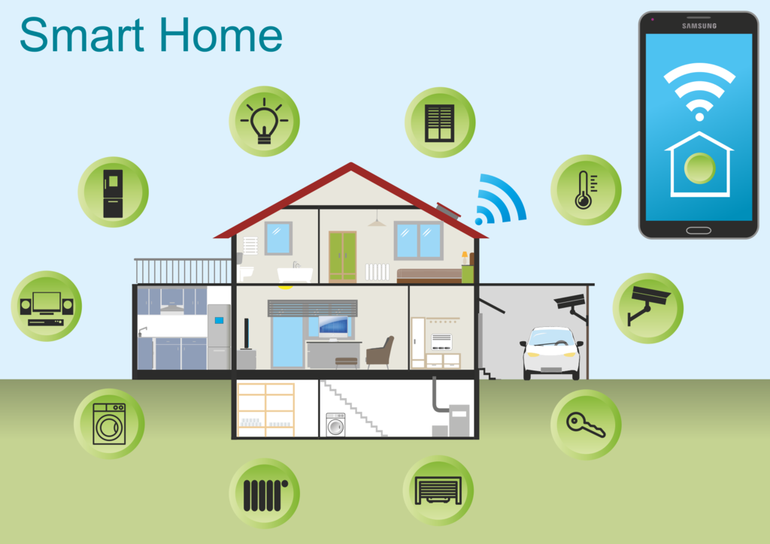
Home Automation
Project Members: Shubam Pandit(85/15) Rachit Gupta(256/15) Ajay Singh(103/15) Shashvat Sharma(202/15)
Mentor: Er. Neeraj Dubey

Slide 2
What is IOT
Internet of things is a growing network of everyday object-from industrial machine to consumer goods that can share information and complete tasks while everybody is busy with other activities.

Slide 3
WHAS(Wireless Home Automation system)
Home automation refers to the ability to automate manual tasks that we perform at home.
It can be realized in many different ways.
Wireless Home Automation system(WHAS) using IoT is a system that uses computers or mobile devices to control basic home functions and features automatically through internet from anywhere around the world.

Slide 4
Motivation for the project
Many existing, well-established home automation systems are based on wired communication. This does not pose a problem until the system is planned well in advance and installed during the physical construction of the building. But for already existing buildings the implementation cost goes very high.
Engineers are rapidly inventing new gadgets to enhance the lifestyle of people. The price of microcontrollers with the ability to talk over a network keeps decreasing year after year and developers can now tinker and build things inexpensively.
With the advent of new libraries and frameworks it is possible to make the homes of 21st century much smarter and automated.

Slide 5
Objectives
To use of latest technology stack and hardware modules, we try to provide a more cost efficient solution for automation.
To make the home more smart by actuating actions on change of state of database.
To provide more than one feature related to home automation.
To make the system secure and scalable.
To use the data about the appliances in a better way.

Slide 6
Goals
Automated Lights
Automated Garage Door
Temperature and Humidity Display
Intrusion Detection
Fire Alarm
RGB Smart Light
Energy consumption data

Slide 7
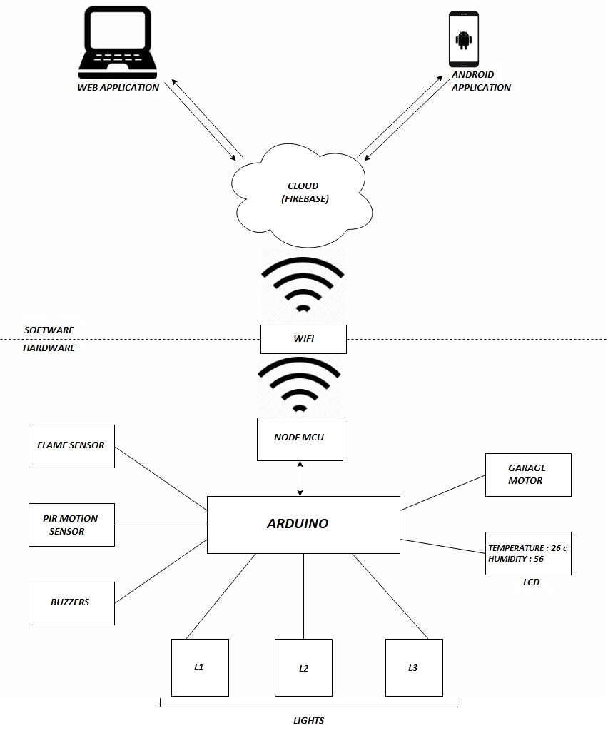
Model Diagram

Slide 8
Technologies used
Our home automation system uses following technologies:
IOT automation
Cloud automation
Data analytics and visualization
Website development
Android app development

Slide 9
Before anything to be used in automating the home, we need a home itself. We used a three dimensional sectioned model in order to replicate a house. For that we used mount sheet and some recycled material to be mounted on top of a hard cardboard. The cut outs in the sheet is used to represent various rooms in a house.

Slide 10
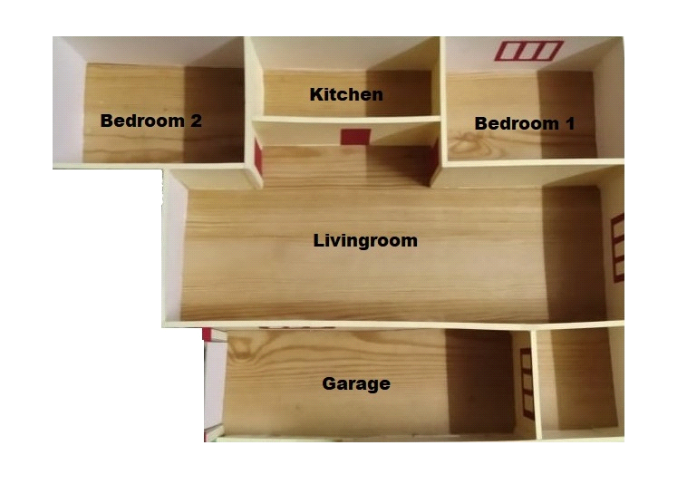
A picture of the top view of the model house

Slide 11
IOT automation

Slide 12
Components used
Components | Specifications
Arduino Uno | 22 pins, operating voltage 6-20 v
NodeMCU | Esp8266 CPU
LED’S(also includes rgb) | 5V
LCD | 16 X 2 Display
PIR Sensor | Voltage: DC 3-5 v, Range: 2-30 cm
Step up Motor | 24BYJ48 Stepper Motor
Infrared Flame Detection Sensor | 3 Pins ; 5 v
Buzzer | 5 v
Jump Wire | M-M, M-, F-F
Breadboard | Standard

Slide 13
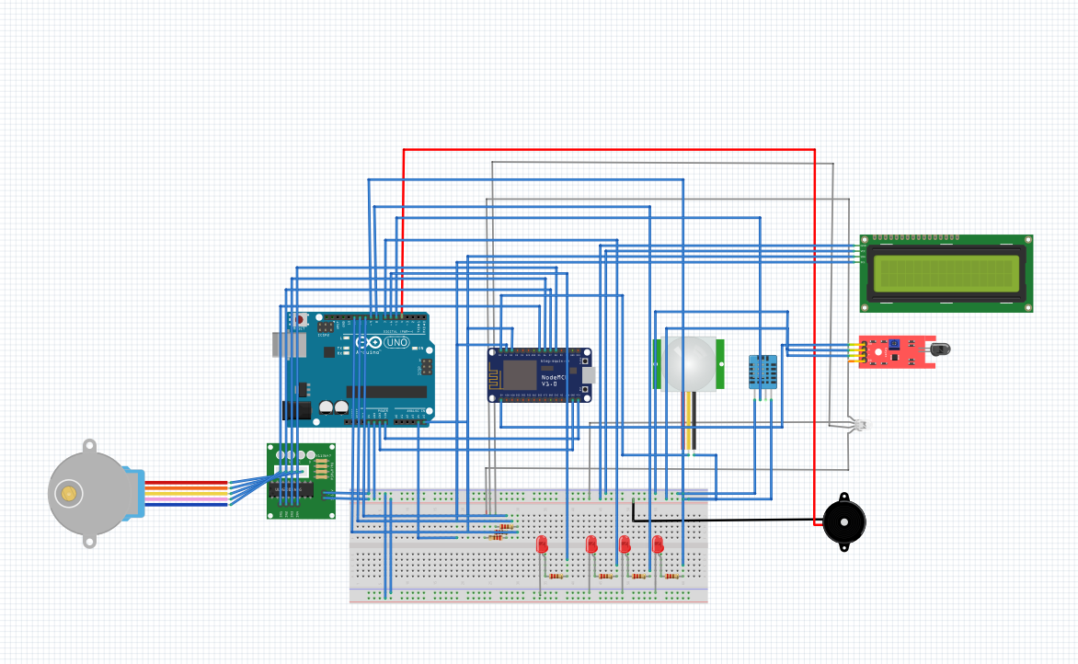
Circuit Diagram

Slide 14
Cloud automation

Slide 15

Firebase
Firebase is a mobile and web application development platform developed by Firebase, Inc. in 2011, then acquired by Google in 2014. As of October 2018, the Firebase platform has 18 products, which are used by 1.5 million apps.

Slide 16
We are using Firebase as a cloud automation platform for our cross-platform applications
Firebase Services used:
Firebase real-time database (NOSQL)
Firebase hosting
Firebase cloud functions

Slide 17
Data analytics and visualization

Slide 18
Chart.js
If you want to visualize data that is analyzed by some formulated algorithms, on your site, or in a presentation, chart.js is a very helpful library in such case. It is one of the essential tools that’s included in the Data Strategist program. It is powerful enough to cover more than just your basic needs.
In this project, chart.js was used to analyze and visualize data about power consumption patterns of the user on specific time instants.

Slide 19
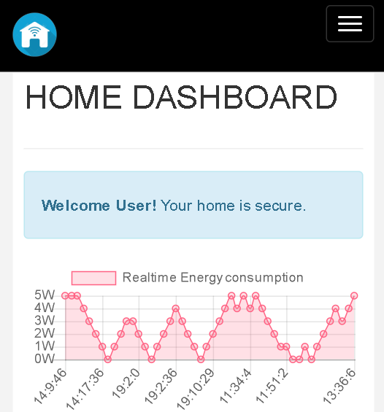

Slide 20
Website development

Slide 21






Technology Stack used for Website

Slide 22
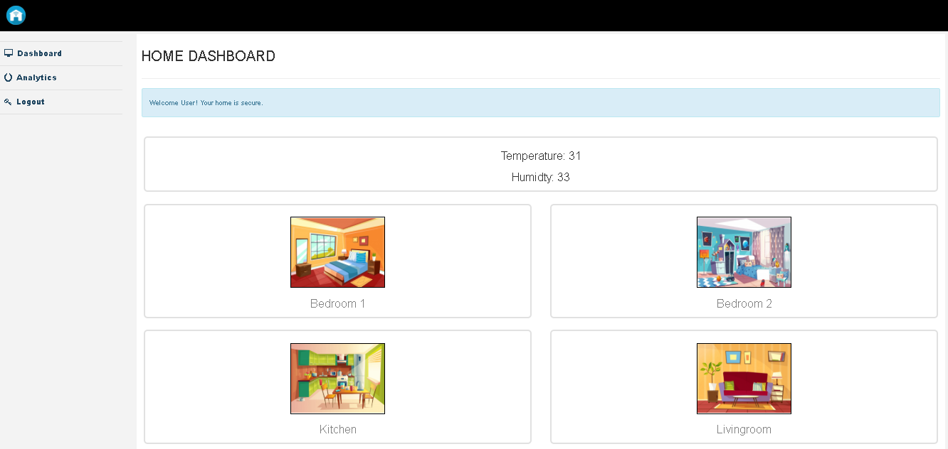

Slide 23
Android app development

Slide 24
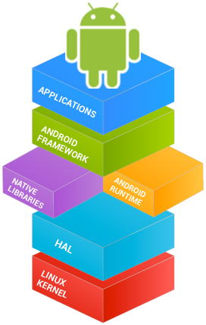

Technology stack used for android

Slide 25
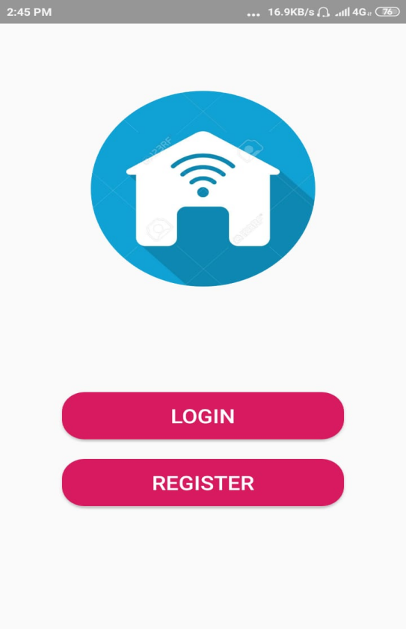
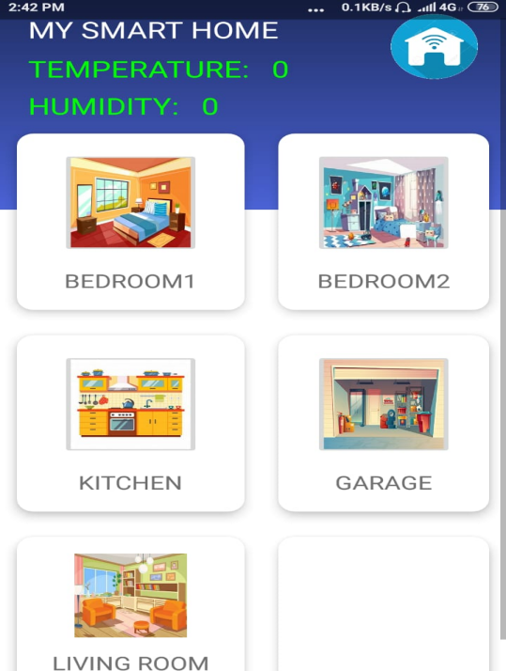

Slide 26
References
[1] R. A. Ramlee, D. H. Z. Tang, and M. M. Ismail, "Smart home system for Disabled People via Wireless Bluetooth," in System Engineering and Technology (ICSET), 2012 International Conference on, 2012, pp. 1-4.
[2] M. Yan and H. Shi, "SMART LIVING USING BLUETOOTH-BASED ANDROID SMARTPHONE," International Journal of Wireless & Mobile Networks (IJWMN), vol. 5, pp. 65-72, 2013.
[3] Deepali Javale, Mohd. Mohsin, Shreerang Nandanwar, and M. Shingate, "Home Automation and Security System Using Android ADK," International Journal of Electronics Communication and Computer Technology, vol. 3, pp. 382-385, 2013.
[4] S. V. A. Syed Anwaarullah, "RTOS based Home Automation System using Android," International Journal of Advanced Trends in Computer Science and Engineering, vol. 2, pp. 480-484, 2013.
[5] A. ElShafee and K. A. Hamed, "Design and Implementation of a WiFi Based Home Automation System," World Academy of Science, Engineering and Technology, pp. 2177-2180, 2012.
[6] A. Z. Alkar and U. Buhur, "An Internet based wireless home automation system for multifunctional devices," Consumer Electronics, IEEE Transactions on, vol. 51, pp. 1169-1174, 2005.
[7] http://ijettjournal.org/Special%20issue/NCEITCS-2017/NCEITCS-141
[8] https://www.irjet.net/archives/V4/i10/IRJET-V4I1061

Slide 27
THANK YOU

Slide 28
Any Questions?

